Slide 1
WORLD STRUCTURE OF THE CURSILLO MOVEMENT
San Francisco
School of Leaders
October 10, 2020

Slide 2
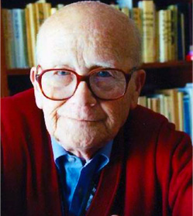
Eduardo Bonnin Aguilo
Founder
May 4,1917 -
February 6,2008

Slide 3
First Cursillo Weekend
First Cursillo – August 19-22, 1944 – Cala Figuera de Santanyi
No. 1 Cursillo – January 7-10, 1949 – Monastery of San Honorato – Mallorca, Spain

Slide 4
De Colores Song
De Colores – “To be well”; To be in the Grace of God” (1951)
Cursillo Movement is banned (1956-1962)
St. Paul the Apostle – Patron Saint of the Cursillo Movement (1963)

Slide 5
OMCC
Organismo Mundial de Cursillos de Cristianidad
World Organization of Cursillos in Christianity
Has 4 international groups
Recognized by the Holy See as member of the International Catholic organizations of the Pontifical Council for the Laity in Rome

Slide 7
4 International Groups of OMCC
GLCC – Latin American Group
APG – Asia Pacific Group
NACG - North American / Caribbean Group
GECC – European

Slide 9
OMCC changes its seat location every 4 years
1998-2001 Germany (GECC)
2002-2005 Brazil (Latin America Group)
2006-2009 USA (NACG)
2010-2013 Australia (APG)
2014-2017 Portugal (GECC)
2018-2021 Mexico (Latin American Group)
2022-2025

Slide 10
NACG North America/ Caribbean Group
President: Hugo Valverde
Vice President: Marisela Rodriguez-Garcia
Treasurer: Jim Santos
Secretary: Jackie DeMesme-Gray
Spiritual Advisor: Fr. Alex Waraksa

Slide 11
NATIONAL CURSILLO CENTER

Slide 12
Nadia Lopez Villadolid National Service Administrator

Slide 13
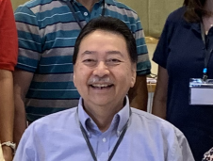
Cef Aguillon
National English Coordinator

Slide 14
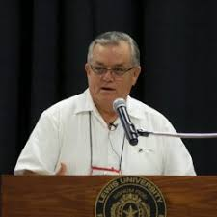
Juan Ruiz
National Spanish Coordinator

Slide 15
BISHOP EDUARDO NEVARES National Episcopal Advisor

Slide 16
FR. MARK SEIKER National Spiritual Advisor

Slide 17
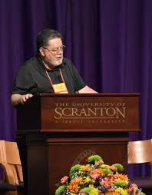
DEACON ANDY CARRILLO
Assistant Spiritual Advisor

Slide 19
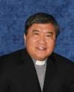
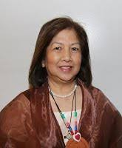
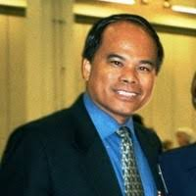
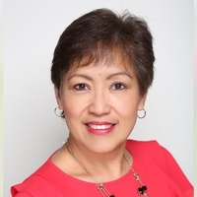
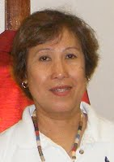
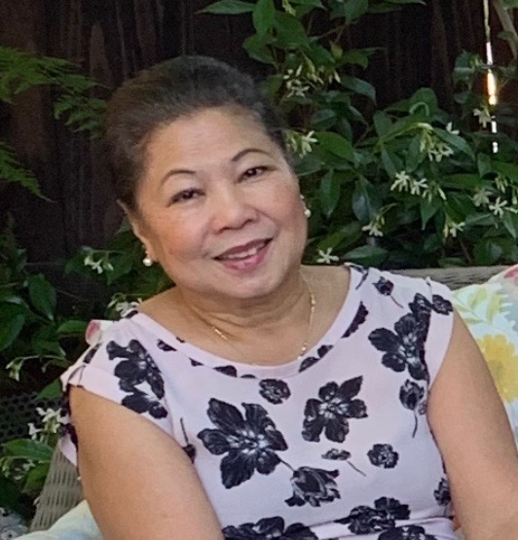

Slide 20
OMCC
NACG
Philippines
Korea
European Group
Spain
APG
Latin America
Canada
USA
Mexico

Slide 21
STRUCTURE OF THE CURSILLO MOVEMENT IN THE UNITED STATES
NATIONAL
REGIONAL
DIOCESE
DIOCESE
REGIONAL
DIOCESE
ULTREYA
ULTREYA
ULTREYA
ULTREYA
ULTREYA
ULTREYA
Group Reunion
Group Reunion
Group Reunion
Group Reunion
Group Reunion
Group Reunion
Group Reunion
Group Reunion
Group Reunion
Group Reunion
Group Reunion
Group Reunion

