Slide 1
DE COLORES

Slide 3
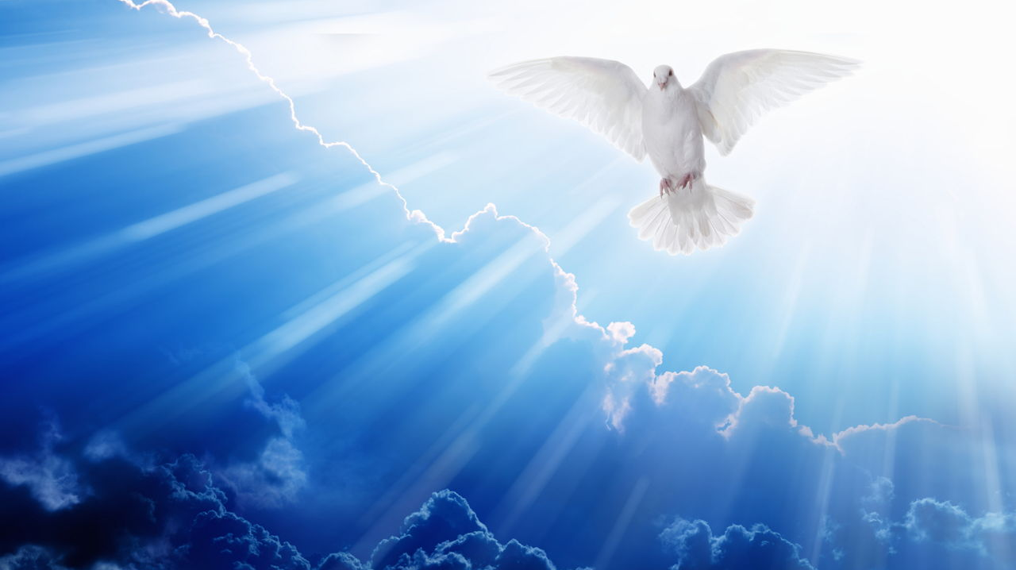
PRAYER TO THE HOLY SPIRIT
Come, Holy Spirit, fill the hearts of your faithful
And kindle in them the fire of your love.
Send forth your Spirit
and they shall be created.
And you will renew
the face of the earth.
AMEN
And pray:
Breathe in me, O Holy Spirit, that my thoughts may all be holy.
Act in me O Holy Spirit, that my work, too, may be holy.
Draw my heart, O Holy Spirit, that I love but what is holy.
Strengthen O Holy Spirit, to defend all that is holy.
AMEN

Slide 4
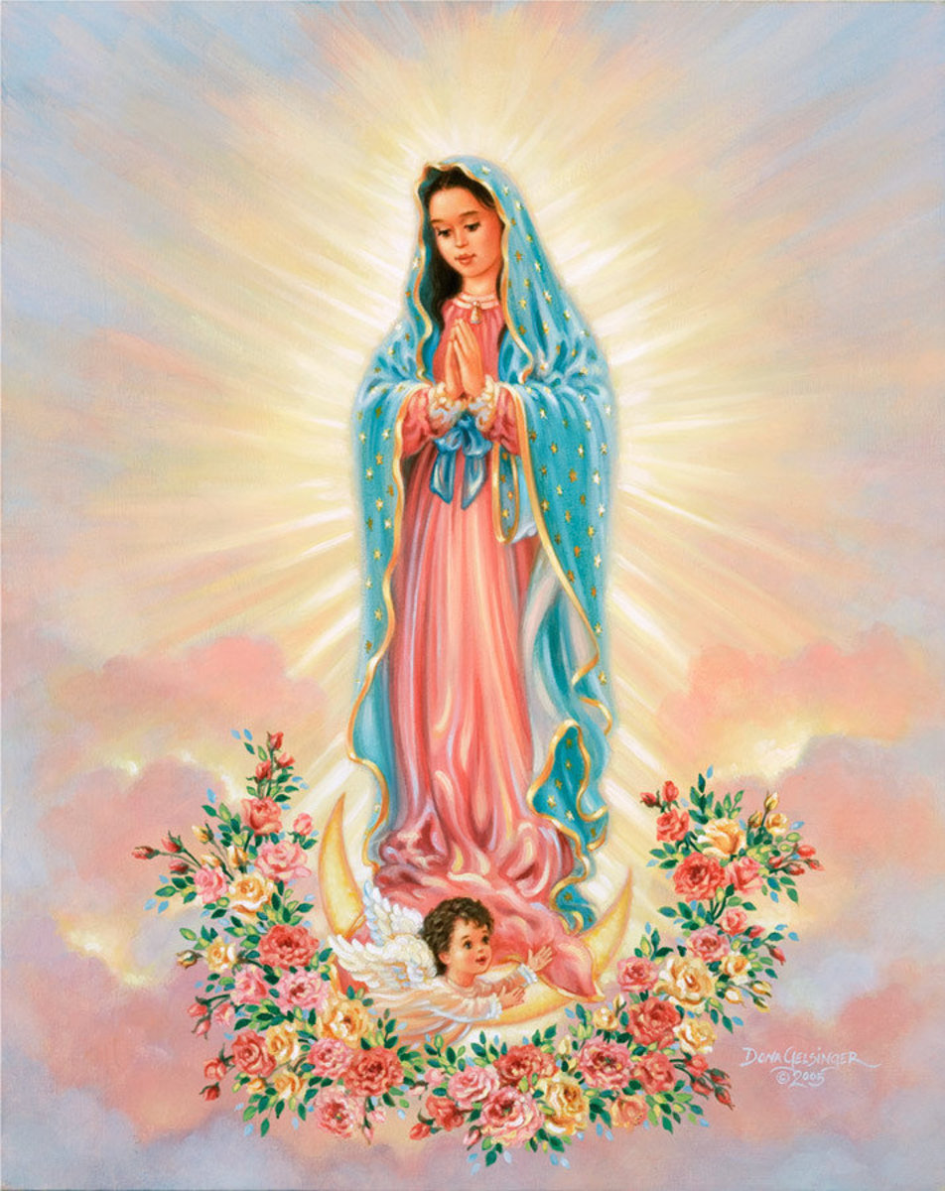
Our Lady of Guadalupe

Slide 5
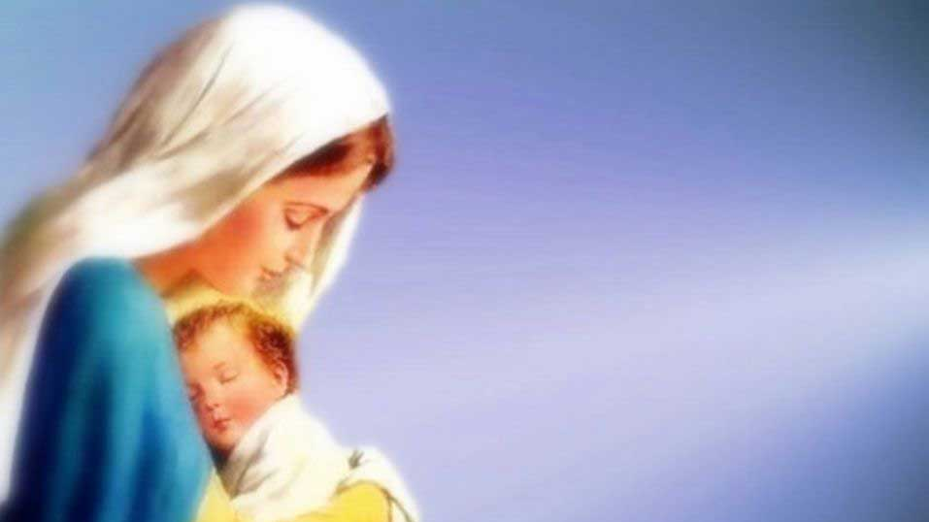
WHO IS THE BLESSED MOTHER FOR YOU?

Slide 6
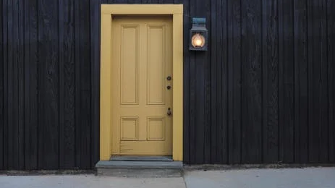

Slide 7
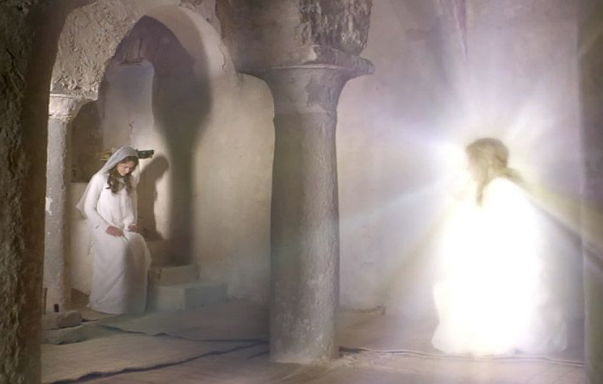
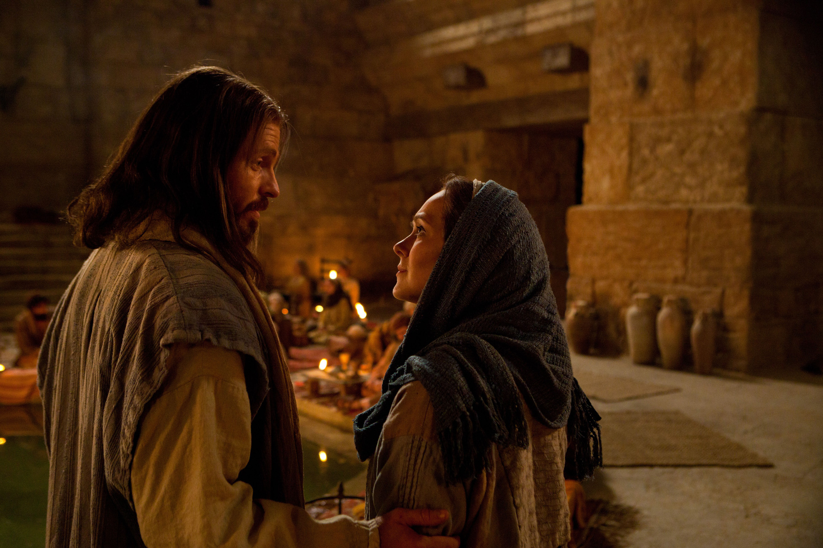
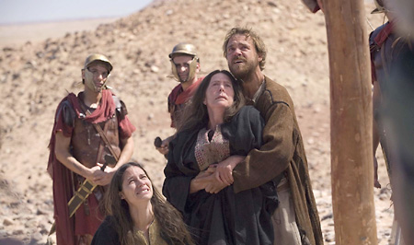
HOW IS THE BLESSED MOTHER INTEGRATED INTO YOUR LIFE AS A SISTER?
The
Annunciation
The Wedding at Cana
Son, behold thy Mother. Woman behold thy Son.

Slide 8
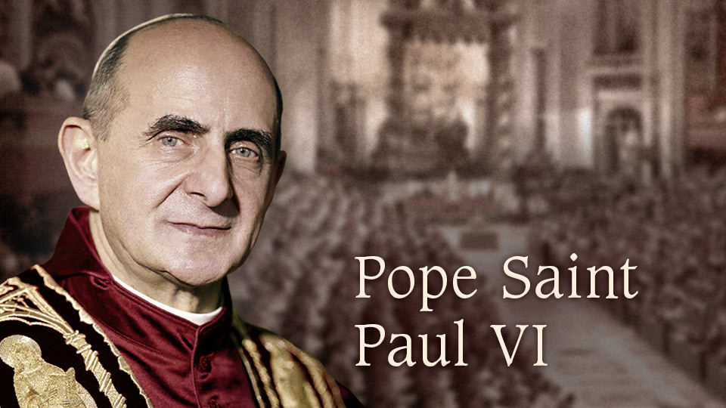
WHY IS THE BLESSED MOTHER IMPORTANT IN THE LIVES OF THE CURSILLISTAS?
YOUR VOCATION
CHRISTIAN VOCATION IS TO FOLLOW THE THEOLOGICAL VIRTUES OF FAITH, HOPE, CHARITY, AND LIVING OUT THE GREAT COMMANDMENT IN UNION WITH CHRIST
A FINAL MARK OF THE CURSILLOS IS A STRONG BELIEF IN THE POWER OF THE GOSPEL AND THE GRACE OF CHRIST TO OVERCOME EVIL.
“I HAVE TOLD YOU ALL THIS SO THAT YOU MAY FIND PEACE IN ME. IN THE WORLD YOU WILL HAVE TROUBLE BUT BE BRAVE. I HAVE CONQUERED THE WORLD.” (John 33)
"MARY HELP OF CHRISTIANS, PRAY FOR US!"

Slide 9
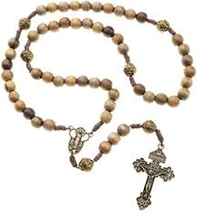
WHY DO WE PRAY THE ROSARY? WHAT IS THE MEANING WHEN I PRAY THE ROSARY?
POWERFUL PRAYER OF INTERCESSION
PROMOTED AS A MEANS OF STRENGTHENING THEIR FAITH
ASK THE BLESSED MOTHER TO BRING THEIR PRAYERS TO GOD AND PLEAD FOR HELP
A DEVOTION IN HONOR OF MARY
A MEDITATIVE PRAYER, MEDITATING ON THE MYSTERIES

Slide 10
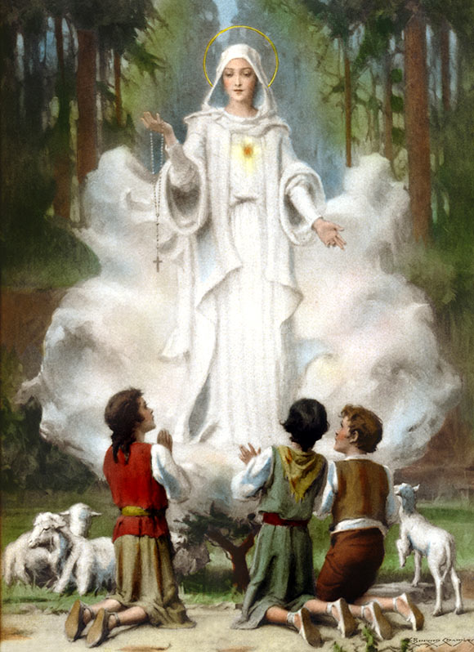
HOW DO CURSILLISTAS EXPLAIN TO OTHERS WHEN QUESTIONED ABOUT OUR PRAYERS TO THE BLESSED MOTHER? WHY PRAY TO MARY?
JESUS HAS GIVEN US HIS MOTHER AS OUR GREAT SPIRITUAL MOTHER - Rev. 12:17
GOD GRANTS BLESSINGS IN ANSWER TO MANY PRAYERS 2 COR 1:11
1 Cor 2:12-26
Rev. 5:8
Lk 1:28 & 38

Slide 11
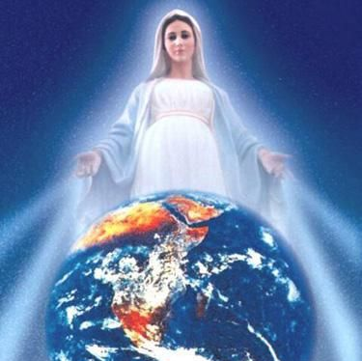
HOW IS THE BLESSED MOTHER THE MOST POWERFUL WOMAN IN THE WORLD?
BLESSED MOTHER IS THE CHOSEN ONE
ARK OF THE COVENANT
BLESSED AMONG WOMEN
FULL OF GRACE
BORN IMMACULATE, CONCEIVED WITHOUT SIN
MOTHER OF GOD
QUEEN OF HEAVEN AND EARTH
ETC.

Slide 12
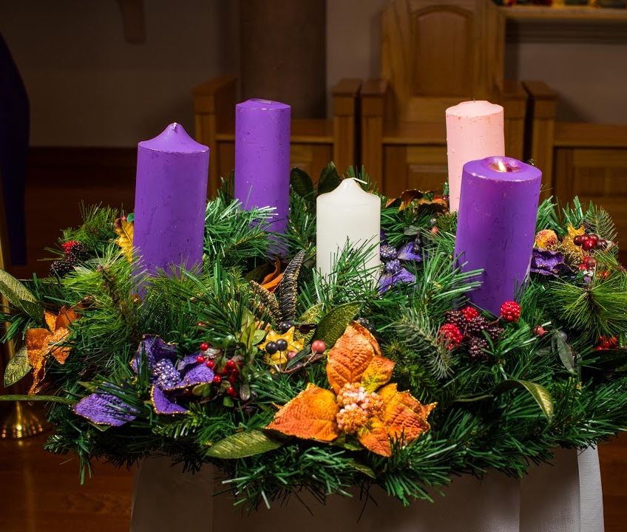
WHAT BLESSED MOTHER QUALITIES SHOULD WE CURSILLISTAS CARRY WITH US ESPECIALLY ON THIS CHRISTMAS SEASON?
LOVE/JOY
3RD SUNDAY = GAUDETE
HOPE
FAITH
JESUS
PEACE

Slide 13
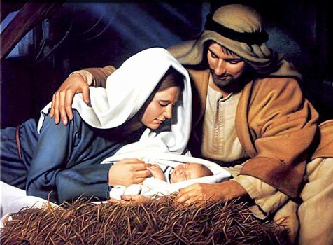
MERRY CHRISTMAS AND A BLESSED NEW YEAR

